Slide 1

National Conference on Kharif Crops -2022
19 April, 2022
Department of Agriculture
Government of Uttar Pradesh

Slide 2

Uttar Pradesh At a Glance
Population (2022) - | 24.34 | Crores
Total Reported Area - | 241 | Lakh ha.
Division - | 18
Districts - | 75
Tehsil - | 350
Blocks - | 825
Gram Panchayat - | 59073
Revenue Village - | 106774
No. of Farmers - | 2.38 | Crores
Work Force in Agriculture - | 3.90 | Crores
Continue.

Slide 3
Agro Climatic Zones | 9
Net Sown Area | 165.38 | Lakh ha.
Net Irrigated Area | 143.92 | Lakh ha.
Irrigation(Net Sown Area) | 87.02 | %
Gross Sown Area | 268.59 | Lakh ha.
Gross Irrigated Area | 217 | Lakh ha.
Cropping Intensity | 162.41 | %
Population Dependent on Agriculture | 68 | %
Agriculture in SGDP | 23.9 (20.19 India) | %
Per Capita Income of the State (2019&20½ | 70419 | Rs.

Slide 4
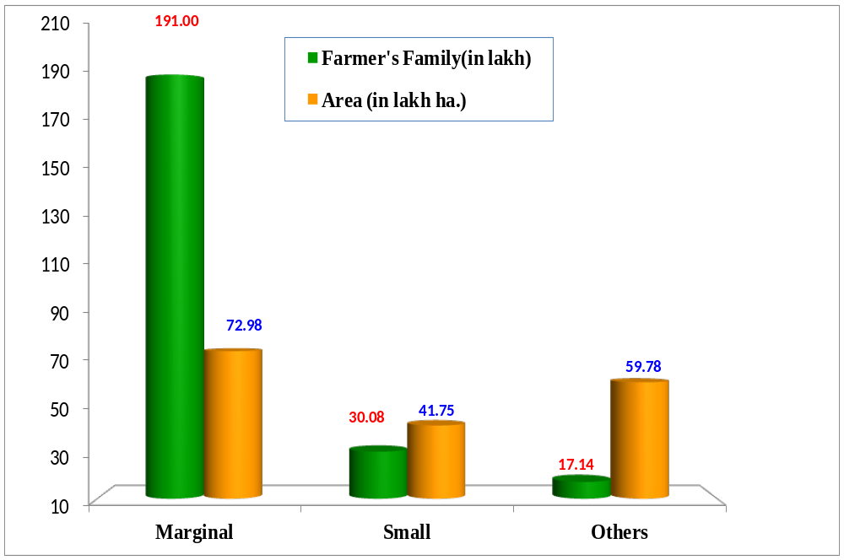

Number of farmers and their operational holdings in UP
(80.18%)
(41.82%)
(34.26%)
(12.62%)
(23.92%)
(7.20%)

Slide 5
Status of Farmers Family and its holdings in Uttar Pradesh (2015-16)
Sl. No. | Categories | Number of farmers family |  | Holdings (ha) |  | Holding size per farmer (ha)
 |  | Number (lakh) | % to total | Lakh hectare | % to total
1 | Marginal | 191.00 | 80.18 | 72.98 | 41.82 | 0.38
2 | Small | 30.08 | 12.63 | 41.75 | 23.92 | 1.39
3 | Semi-Medium | 13.14 | 5.52 | 35.60 | 20.40 | 2.71
4 | Medium | 3.77 | 1.58 | 20.75 | 11.89 | 5.50
5 | Large | 0.23 | 0.10 | 3.43 | 1.97 | 14.91
 | Total | 238.22 |  | 174.51 |  | 0.73

Slide 6
Assessment of Production: Rabi 2021-22
Unit- Lakh M.T
Sl.N0. | Crops | Rabi 2020-21 |  | Rabi 2021-22
 |  | Target | Achievement | Target | Assessment*
1 | Wheat | 390.00 | 374.79 | 391.25 | 377.24
2 | Barley | 4.95 | 4.88 | 5.20 | 5.13
3 | Maize | 0.50 | 0.43 | 0.80 | 0.25
4 | Gram | 8.10 | 7.60 | 8.37 | 7.96
5 | Pea | 5.60 | 5.62 | 7.85 | 6.42
6 | Arhar | 3.36 | 3.54 | 4.98 | 3.47
7 | Lentil | 5.00 | 4.79 | 7.17 | 5.08
8 | Food Grains | 417.51 | 401.65 | 420.63 | 402.08
9 | Oil Seeds | 11.47 | 10.23 | 11.84 | 11.20
Total |  | 428.98 | 411.88 | 432.47 | 413.28
* Third Advance Estimate

Slide 7
Assessment of Productivity: Rabi 2021-22
Unit- Qtl/ha
Sl.N0. | Crops | Rabi 2020-21 |  | Rabi 2021-22
 |  | Target | Achievement | Target | Assessment*
1 | Wheat | 39.50 | 38.04 | 39.50 | 38.60
2 | Barley | 31.50 | 31.09 | 31.50 | 31.09
3 | Maize | 40.00 | 26.48 | 40.00 | 28.17
4 | Gram | 14.06 | 12.43 | 14.06 | 12.95
5 | Pea | 17.00 | 15.56 | 17.00 | 16.45
6 | Arhar | 13.98 | 11.96 | 14.00 | 11.96
7 | Lentil | 11.75 | 10.14 | 11.75 | 10.29
8 | Rapseed / Mustard | 14.85 | 14.38 | 14.85 | 14.60
9 | Linseed | 7.00 | 5.60 | 7.00 | 6.26
.
* Third Advance Estimate

Slide 8
Area & Production : Kharif 2022
Crops | 2021 Achievement |  | 2022 Target
 | Area (Lac ha.) | Production (Lac MT.) | Area (Lac ha.) | Production (Lac MT.)
Rice | 59.70 | 159.68 | 59.00 | 177.00
Jowar | 1.71 | 2.70 | 2.15 | 3.40
Bajra | 9.05 | 19.50 | 9.80 | 24.06
Maize | 6.91 | 14.64 | 7.80 | 21.61
Coarse Cereals | 0.07 | .05 | 0.15 | 0.15
Urd | 5.14 | 2.56 | 7.25 | 5.02
Moong | 0.38 | 0.14 | 0.40 | 0.25
Arhar | 2.96 | - | 3.60 | 3.60
Total Food Grains | 85.91 | 199.29 | 90.15 | 235.08
Oilseeds | 4.20 | 1.83 | 5.88 | 3.64
Total | 90.11 | 201.12 | 96.03 | 238.72

Slide 9
Productivity: Kharif 2022
Unit- Qtl/ha.
Crops | Kharif 2021 |  | Kharif 2022
 | Target | Achievement | Target
Rice | 29.60 | 26.75 | 30.00
Jowar | 15.80 | 15.78 | 15.80
Bajra | 24.51 | 21.56 | 24.55
Maize | 27.60 | 21.23 | 27.70
Coarse Cereals | 10.00 | 6.62 | 10.00
Urd | 6.83 | 4.98 | 6.93
Moong | 6.22 | 3.58 | 6.25
Til | 3.30 | 2.26 | 3.35
Groundnut | 11.75 | 11.39 | 11.80
Soyabean | 15.50 | 5.21 | 15.55

Slide 10
STRATEGY

Slide 11
Technology Dissemination
Raising of nursery to be ensured from 25th May to 20th June.
Transplanting of paddy : 15% by 15th June, 30% by 30th June, 50% by 7th July and 5% by 25th July for scented rice.
Location specific crop planning and adaption of recommended practices.
17000 "Million Farmers School" (Kisan Pathshala) to be held during Kharif 2022 in 59073 Gram Panchayats.
Conti.…

Slide 12
Technology Dissemination
Intensification of modern extension techniques through Mass Media, Kisan call center, mobile message/app.
Farmer’s Fair in each agro climatic zone and at District/ block level.
Farmer’s Meeting (Gosthies) at state/ division/ district and block level.
Agricultural advisory to farmer on regular interval through m-kisan portal.
Conti.…

Slide 13
Crop wise micro planning at gram panchayat level.
Promotion of SRI system and hybrid seed in rice.
Popularization of Drum seeder for direct sowing of rice.
Crop demonstrations at farmer’s field under different scheme- NFSM, NFSM (OS/TBO) ATMA, PKVY, CDP, Namami Gange and Natural Farming etc.
More than 2.00 lakh farmers are to be trained under Farm school and different programme/schemes.

Slide 14
Seed
UP State has achieved 45% SRR against the target of 44 % SRR in Kharif-2021.
SRR target is being set on 46% for Kharif 2022.
8.41 lakh quintal seed has been distributed against the target of 8.20 lakh quintal in Kharif-2021.
8.56 lakh quintals seed distribution target is being set for Kharif -2022.
3.04 lakh quintals Hybrid seed has been distributed against the target of 3.07 lakh quintal in Kharif – 2021.
3.07 lakh quintal Hybrid seed distribution target is being set for Kharif -2022.
contin...

Slide 15
Subsidy on the seed is being provided as per norms of GOI & Govt .of UP.
Subsidy is being transferred to the registered farmers through DBT.
State sector subsidy equivalent to central subsidy is being provided on additional seed distributed over/above targets of Central schemes and in those districts which are not covered under Central schemes.
Variety wise and district wise requirement of seeds is being finalized and arrangement made up with UPSDC.

Slide 16
Seed
S.N. | Crop | Seed Distribution Kharif-2021 ( in qtls) |  |  | Seed Distribution Target Kharif-2022 ( in qtls) |  |  | Seed Replacement Rate (%)
 |  | Subsidy | Non-subsidy | Total | Subsidy | Non-subsidy | Total | Kharif 2021 | Kharif 2022 (T)
1 | Paddy | 58494 | 667070 | 725564 | 99900 | 635100 | 735000 | 54 | 55
2 | Maize | 0.00 | 19757 | 19757 | 0 | 20500 | 20500 | 14 | 14
3 | Jowar | 0.00 | 6234 | 6234 | 100 | 6100 | 6200 | 23 | 23
4 | Bajra | 0.00 | 3924 | 3924 | 200 | 4000 | 4200 | 9 | 9
5 | Urd | 4223 | 27877 | 32100 | 6370 | 26130 | 32500 | 27 | 27
6 | Moong | 1432 | 5674 | 7106 | 1874 | 4626 | 6500 | 64 | 60
7 | Arhar | 306 | 15602 | 15908 | 4576 | 13424 | 18000 | 31 | 36
8 | Til | 286 | 4197 | 4483 | 1148 | 3352 | 4500 | 33 | 33
9 | Soyabean | 44 | 3946 | 3990 | 598 | 3602 | 4200 | 25 | 26
10 | Groundnut | 1383 | 21217 | 22600 | 814 | 23686 | 24500 | 24 | 25
11 | Jute | 1.00 | 0.00 | 1.00 | 5 | 0 | 5 | 0 | 0
12 | Cotton | 78.00 | 0.00 | 78.00 | 368 | 0 | 368 | 0 | 0
13 | Kodo | 21 | 0.00 | 21 | 109 | 0 | 109 | 0 | 0
14 | Sawa | 45 | 0.00 | 45 | 109 | 0 | 109 | 0 | 0
 | Total/Avg. | 66313 | 775498 | 841811 | 116171 | 740520 | 856691 | 45 | 46

Slide 17
Hybrid Seed
Crops | Hybrid Seed Distribution Kharif- 2021 ( in qtls) |  |  | Hybrid Seed Distribution tentative Target Kharif- 2022 ( in qtls)
 | Subsidy | Non-subsidy | Total | Subsidy | Non-subsidy | Total
Hybrid Paddy | 9753 | 202900 | 212653 | 17217 | 194803 | 212020
Hybrid Maize | 2165 | 60750 | 52915 | 2976 | 60574 | 63550
Hybrid Jowar | 143 | 8696 | 8839 | 464 | 8626 | 9090
Hybrid Bajra | 905 | 19200 | 20105 | 4349 | 18091 | 22440
Total | 12966 | 291547 | 304512 | 25006 | 282094 | 307100

Slide 18
FERTILIZER
S. No. | Fertilizer | Season Requirement | Target month of April, 2022 | Opening Balance as on 01.04.2022 | Receipt as on date 11.04.2022 | Availability as on date 11.04.2022 (5+6) | Sale as on date 11.04.2022 | Closing Balance (7-8)
1 | 2 | 3 | 4 | 5 | 6 | 7 | 8 | 9
1 | UREA | 38.50 | 3.00 | 11.01 | 1.35 | 12.36 | 0.72 | 11.64
2 | DAP | 8.50 | 1.00 | 2.52 | 0.57 | 3.09 | 0.35 | 2.74
3 | NPK | 3.00 | 0.50 | 0.41 | 0.27 | 0.68 | 0.14 | 0.54
4 | MOP | 2.00 | 0.40 | 0.20 | 0.00 | 0.20 | 0.00 | 0.20
5 | SSP | 3.00 | 0.50 | 1.36 | 0.07 | 1.43 | 0.10 | 1.33
TOTAL |  | 55.00 | 5.40 | 15.50 | 2.26 | 17.76 | 1.31 | 16.45

Slide 19
DEMAND AND AGREED ALLOCATION
Fertilizer | Kharif 2022 |  | Sale during Kharif 2021
 | Demand | DOF Agreed Allocation
UREA | 41.00 | 38.50 | 34.24
DAP | 12.00 | 8.50 | 5.39
NPK | 5.00 | 3.00 | 2.01
MOP | 2.50 | 2.00 | 0.67
SSP | 3.05 | 3.00 | 2.75
TOTAL | 63.55 | 55.50 | 45.06

Slide 20
Month-Wise Breakup of Assessed Requirement
Sl.No. | Month | UREA | DAP | NPK | MOP | SSP
1- | April 2022 | 3.00 | 1.00 | 0.50 | 0.40 | 0.50
2- | May 2022 | 5.00 | 1.25 | 0.50 | 0.30 | 0.25
3- | June 2022 | 6.25 | 1.35 | 0.50 | 0.30 | 0.50
4- | July 2022 | 10.00 | 2.25 | 0.50 | 0.25 | .50
5- | August 2022 | 10.25 | 1.25 | 0.25 | 0.25 | .50
6- | September 2022 | 4.00 | 1.40 | 0.75 | 0.50 | 0.75
 | Total | 38.50 | 8.50 | 3.00 | 2.00 | 3.00

Slide 21
PLANT PROTECTION
Ensuring availability of quality pesticides through 50347 Government & Private Sell points.
A target of 9740 MT/KL has been fixed for Kharif 2022. In Kharif 2021, 8870.53 MT/KL pesticides were distributed.
Bio-pesticide distribution is being promoted through 9 IPM Labs established in the State.
In Kharif 2022, 2800 MT/KL target has been fixed for bio-pesticides distribution and 2104.46MT/KL was distributed in Kharif 2021.

Slide 22
Pesticides
S.N. | Item | Unit | Kharif 2021 Achiev. | Kharif 2022 Target | Availability April 2022
1. | Insecticide Dust/Granule | M.T. | 3144.47 | 3280 | 445.54
2. | Insecticide Liquid | K.L. | 737.10 | 660 | 223.57
3. | Fungicides | M.T./K.L. | 770.14 | 770 | 238.74
4. | Weedicides | M.T./K.L. | 2038.15 | 2140 | 388.45
5. | Rodenticides/Fumigants | M.T. | 76.21 | 90 | 21.69
6. | Bio-pesticides | M.T./K.L. | 2104.46 | 2800 | 513.32
 | TOTAL |  | 8870.53 | 9740 | 1831.31

Slide 23
Agriculture Mechanization
Scheme | Physical (2022-23) | Financial (2022-23)
Sub Mission on Agricultural Mechanization | Implements-30696 CHC-1350. Drone Demostration-600 Drone Purchase by FPOs/CHC/FMB-250 | 290 Cr.
Promotion of Agricultural Mechanization for in-Situ Management of crop residue | Implements-7023 FMB-2450 | 180 Cr.

Slide 24
Priority Schemes/Programmes of U.P. Govt.

Slide 25
1- Natural Farming
For demonstrations, Natural farming has been taken up in 5 State Agriculture Universities, KVKs, SIMA Rehmankheda and 10 RATDS.
Two State level conferences have been organised at C.S.A. Agri. & Tech. University, Kanpur and B.H.U., Varanasi on 22.01.2020 & 16.12.2021 respectivily.
Total 286915 farmers have been trained in last two years.
More than 75000 ha. area has been proposed in 50 districts under BPKP including 5 Km Stretch on both sides of River Ganga in 27 districts.
continue.....

Slide 26
From State sector, total 47000 ha. area has been proposed in 7 districts of Bundelkhand region.
The scheme will be launched from Kharif 2022.
Cluster will be formed at block level covering 500 to 1000 ha. area.
Selection of Champion Farmer, one Senior Local Resource Person, 2 Local Resource Person & 10 Community Resource Person at cluster level.
State level Seminar/Training will be organised in the month of May, 2022.

Slide 27
2- PM- KUSUM SCHEME
Restoration of recommended 15% top up subsidy before Covid period.
Execution of schemes after approval of Hon'ble Council of Ministers.
Online selection of farmers through portal.
Additional financial requirement of Rs 200 Crore under state scheme for 5 years.
5000 Solar Pumps installation target in the next 6 months.

Slide 28
3- Farmer Producer Organizations (F.P.O.)
Implementing agency wise allocation of targeted 625 Crop specific F.P.O.
Selection of development blocks.
The linkage of Block wise Crop specific selected farmers by implementing agencies.
The seleciton of cluster based business institutions by implementing agencies.
Combined training of mentor and representatives of F.P.O.

Slide 29
